Slide 1
Tuesday, February 28th
Current events
Notes today
HW: Complete Chapter 11 (p.316, #16- 32) Due tomorrow!

Slide 2
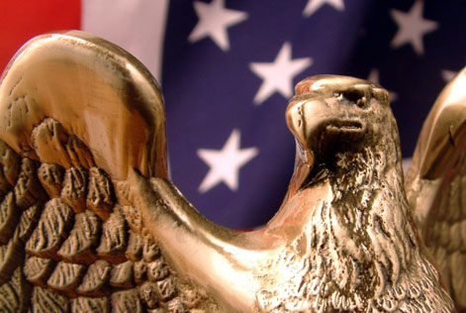
The Powers of Congress

Slide 3
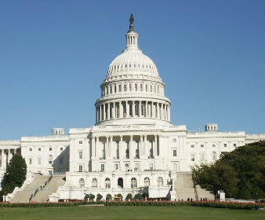
Legislative Powers
Enumerated/Delegated (Expressed) powers are specifically given to Congress in the Constitution.
Article 1, Section 8 of the Constitution spells out the major powers of the Congress.
The first 17 clauses list specific powers granted to Congress.

Slide 4
https://www.youtube.com/watch?v=pfaOUdQjCfI

Slide 5
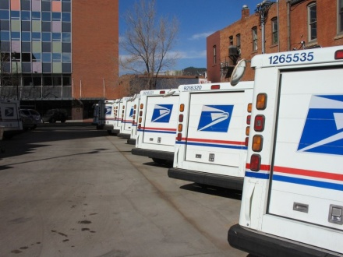
“Enumerated/Delegated/ Expressed” Powers
Examples of Enumerated/Delegated Powers are:
Raising & supporting an army and a navy
Establish uniform rules of naturalization (also called “naturalization laws”)
Print & coin money
Establish post offices
Declare War

Slide 6
https://www.youtube.com/watch?v=WJOKU9ql85c
Until 2:28

Slide 7
Legislative Powers
Implied powers are not specifically listed for Congress but are understood according to Article 1, Section 8, Clause 18. (look at page 60)
This is often called the “elastic clause” because it gives Congress authority to stretch its power and do whatever is “necessary and proper” to do their job & carry out their listed powers

Slide 8
“Implied” Powers
Examples of Implied Powers (from the Necessary and Proper Clause) are:
To raise and support an army implies Congress can implement a draft
Collecting taxes implies that Congress could use the money to support programs
Establishing naturalization rules implies that Congress can limit the number of immigrants.

Slide 9
Congressional Powers
Most congressional power is related to making laws for the nation.
However, Congress has many other powers as well:
Regulating interstate (between states) commerce (business)
Raising and spending money
Creating federal courts
Dealing with foreign countries
Governing all federal property (military bases, national parks)

Slide 10
Congress & Funding
To fund the U.S. Government, Congress has the power to levy taxes.
All tax bills are proposed or start in the House of Representatives and must be approved by the Senate. Why do you think they start in the House?

Slide 11
Congress & Taxing
Congress will add taxes to raise money for public needs or to protect the people, i.e. health and safety or domestic industry.
Congress is Limited on its taxing powers:
Can not tax for private benefit
May not tax exports, only imports from other countries
Direct taxes, outside of income, are to be levied by the states, as they depend on population.
All indirect taxes(like sales taxes) must be levied at the same rate in every part of the country.
From Article I, Section 8 Clause I, Section 9 Clause 4 + 5, and the 16th Amendment

Slide 12
Congress & Borrowing Power
Article I, Section 8, Clause 2 gave congress the power “to borrow Money on the credit of the United States”
For decades, the Federal Gov’t has practiced deficit financing, regularly spending more than it has and borrowing the difference.
Today’s Federal Debt is $19,913,901,120,188.15. Federal Debt per person is about $61,029

Slide 13
Congress & Trade
Article 1, Section 8, Clause 3 , also called the “Commerce Clause” is the basis for many of Congress’ most important powers – this allows Congress the power to regulate foreign and domestic trade.
Domestic - interstate

Slide 14
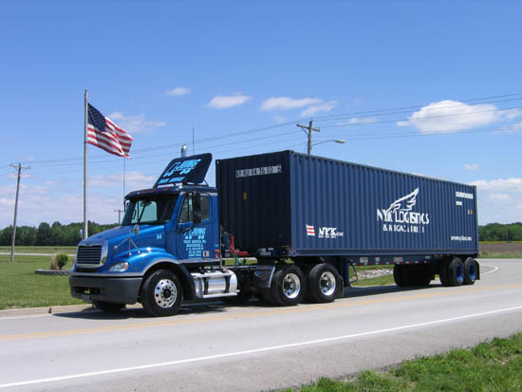
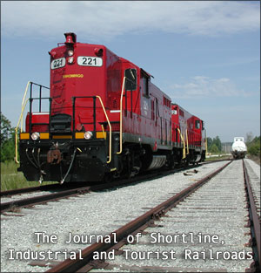
Congress & Trade
Examples of powers from this clause:
Air Traffic
Railroads
Trucking
Radio / TV
Pollution
Stock Market

Slide 15
Congress and Currency
Article I, Section 8, Clause 5 gives Congress the power to “Coin Money and regulate the Value thereof” this power is denied to the States.
Wanted to get rid of each state issuing its own currency
Legal tender would not come into existence until 1861
Congress also has the power to establish the legal proceeding of bankruptcy, most cases are heard in federal district courts and not with the states.

Slide 16
Congress & Foreign Relations
While the President has the authority to negotiate treaties and deal with other nations, all treaties must be approved by the Senate.
This is an example of a _____ and _____?

Slide 17
Congress & Foreign Relations
While the President has the authority send troops into combat for up to 60 days, only Congress has the power to declare war or create an army.
World War II was the last “declared war” in the U.S. (1941-1945)

Slide 18
Non-Legislative Powers
“Non-Legislative” Powers are powers that Congress has the does not relate to passing laws.
Examples:
Proposing Amendments
Approvals of Nominations (Senate)
Removal from Office and Impeachments
Investigations

Slide 19
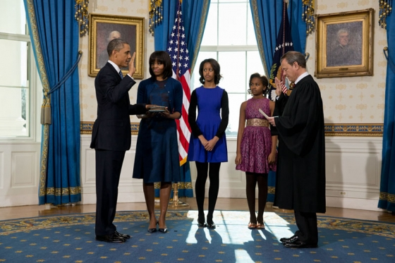
Non-Legislative Powers
Check and Balance --- The Senate can approve or reject presidential nominees or appointments for various offices.
Check and Balance - Congress can also remove any elected officials from office in cases of wrong-doing.

Slide 20
“Impeachment”
“Impeach” means to formally accusing officials of misconduct or wrong-doing.
Impeachments are usually handled by a trial.
The House always begin impeachment procedures.
If the majority of the House votes for impeachment, it moves to the Senate.
The Senate acts as jury, while the Chief Justice of the Supreme Court acts as judge.
2/3 needed for guilt to be found in the impeachment (67 Senators)

Slide 21
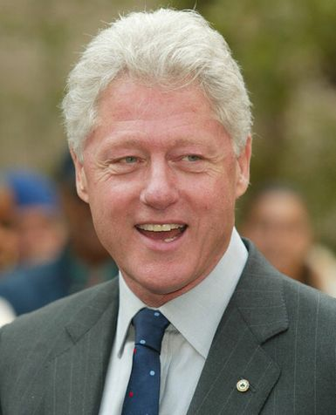
“Impeachment”
Only two presidents have ever been impeached (neither removed from office).
Andrew Johnson (1868) and Bill Clinton (1998)

Slide 22
Non-Legislative Powers
Congress also conduct investigations into serious issues.
Organized crime, fund raising, Watergate, Iran-Contra, etc.

Slide 23
Limits to Congressional Power
The Constitution limits the power of Congress, placing restrictions on their power.
Congress may not favor one state over another, tax exports, tax interstate trade.

Slide 24
Ways that Congressional Power is Limited
The Constitution also reserves many powers to the states and other branches (10th Amendment)
Congress can not interfere with these Reserved powers.
The Supreme Court can declare laws unconstitutional and the President can veto laws.

Slide 25
Limits to Congressional Power
Congress can not pass “bills of attainder” (laws that punish a person without a jury trial)

Slide 26
Limits to Congressional Power
Congress can not suspend the “writ of habeas corpus” (court order requiring police to bring a prisoner to court to explain why they are holding that person).

Slide 27
Limits to Congressional Power
Congress can not pass “ex post facto laws” (or laws that make an act a crime AFTER it has been committed)

